Slide 1
Overview of Statistics for Data Science and Business Intelligence
Statistics basics including:
Sample
Population
Types of statistics
Sehrish Aqeel
www.aisciences.io

Slide 2
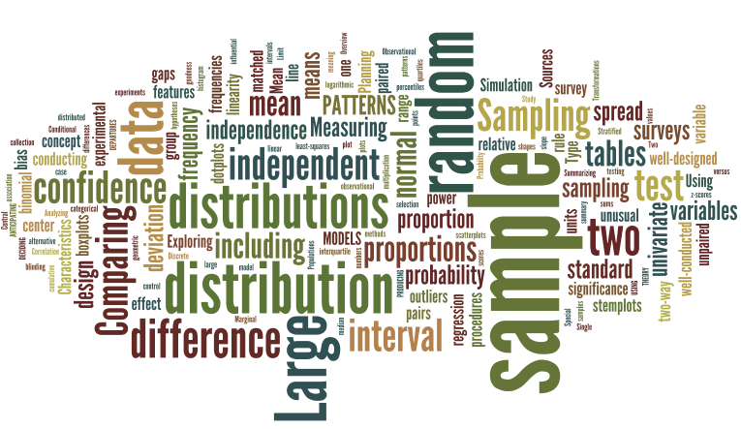
An Introduction to Statistics
What is Statistics?
The word Statistics comes from the Latin word Status, meaning a political state, originally meant information useful to the state.

Slide 3
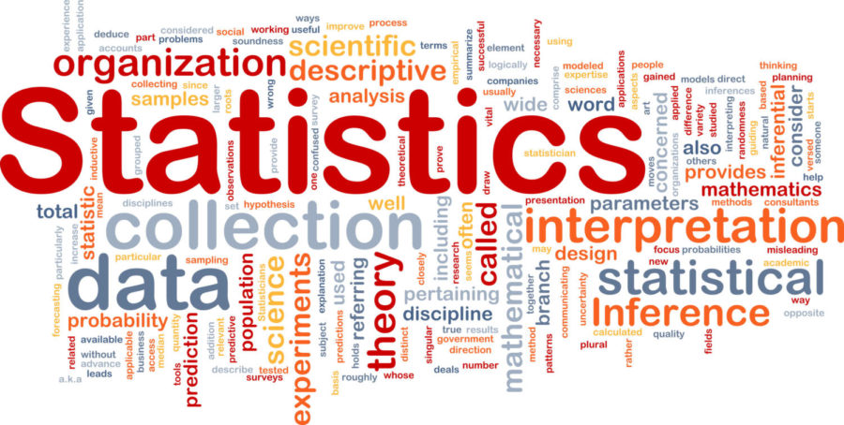
An Introduction to Statistics
A Statistics is defined in different ways:
1. A numerical facts systematically arranged.
2. A discipline that includes procedures and techniques used to collect, process and analyze numerical data.
Statistics is a discipline of study dealing with the collection, analysis, interpretation, and presentation of data.

Slide 4

An Introduction to Statistics
Some examples of Statistical data are:
1. Population of males in Africa.
OR
2. Population of females in France.
OR
3. The number of universities in the USA
OR
4. The number of students of this course.

Slide 5

Types of Statistics
A Statistics is usually divided into two disciplines.
Inferential Statistics
Descriptive Statistics

Slide 6
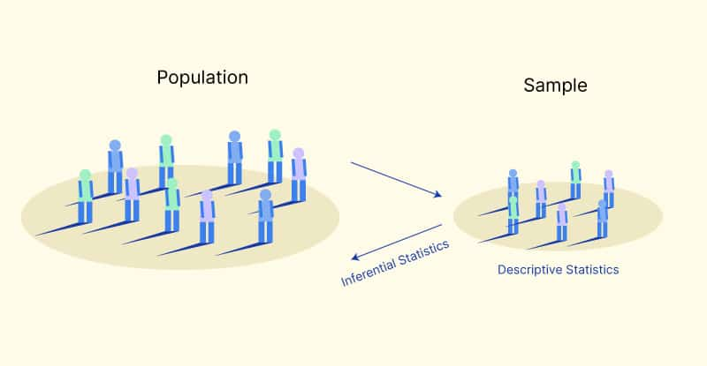
Inferential Statistics
It deals with procedures for making inferences about characteristics that describes the larger group of data (population).
Inferential statistics consists of techniques for reaching conclusions about a population based upon information contained in a sample.

Slide 7
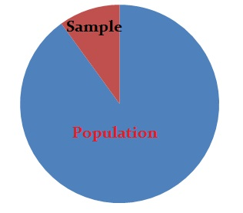
Population and Sample
The population is the complete collection of individuals, items, or data under consideration in a statistical study.
The portion of the population selected for analysis is called the sample.

Slide 8
Population and Sample
Population | Sample
All registered voters | A telephone survey of 600 registered voters
All owners of handguns A telephone survey of 1000 handgun owners | A telephone survey of 1000 handgun owners
Households headed by a single parent | The results from questionnaires sent to 2500 households headed by a single parent
The CEOs of all private companies | The results from surveys sent to 150 CEO’s of private companies

Slide 9

Descriptive Statistics
It deals with the concepts and methods concerned with summarization and description of the important aspects of numerical data.
The use of graphs, charts, and tables and the calculation of various statistical measures to organize and summarize information is called descriptive statistics.
Descriptive statistics help to reduce our information to a manageable size and put it into focus.

